Slide 1




Using Data to Evaluate Network Costs and Identify Opportunities for Improvement/Optimization
February 28, 2026
Notes:
Intro slides 2-6: Helena
Prompt/Judging: Shawn

Slide 2
Our Team
Harold Arnold
Supervisor
Network Services Data Analytics
Adrienne Alexander
Analyst
Infra. Process, Tools, & Automation
Serina Johnson
Supervisor
Infra Operations Center Batch
Wells Cooner
Manager
TO Data Center Program
Gabe Thomas
Analyst
Network Services Data Analytics

Slide 3

Who is Southern Company?

Slide 4
Who is Southern Company?
Utility company who makes, moves and sells energy
Leading producer of clean, safe, reliable, and affordable energy
Portfolio of subsidiaries includes...
Electric utilities: Alabama Power, Georgia Power, Mississippi Power...
Gas utilities: Atlanta Gas & Light, Nicor Gas, Virginia Natural Gas...
Generating plants
Telecommunications Companies: Southern Linc, Southern Company Services, STI

Slide 5
Who is Southern Company?
Ranked #2 in Fortune Magazine's 2025 World's Most Admired Companies in the Electric & Natural Gas Utilities category
If you can imagine a job, we likely have it within our company
Doctors, Lawyers, Real Estate Agents, Teachers, Chemists, Accountants, Pilots, Electricians, Mechanics, Security Officers, Data Scientists, Engineers
We have a large Technology Organization which includes the Infrastructure Services Organization

Slide 6






What is Infrastructure Services?
Infrastructure Services
Infrastructure Solutions
Computing Services
Infrastructure Operations
Network Services
Data Center Program
Telecom Services

Slide 7
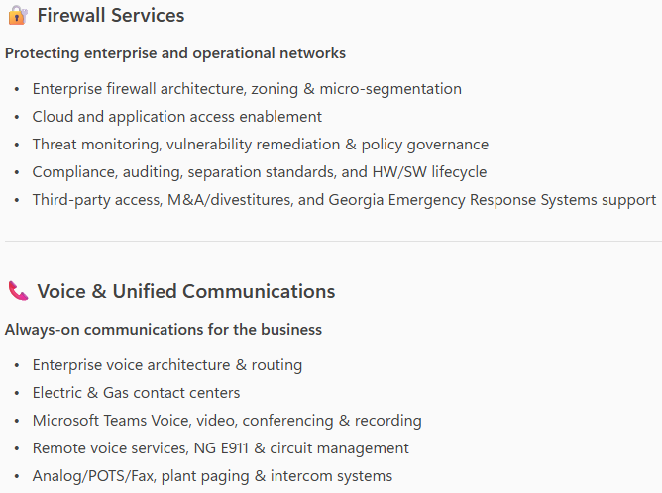
What is Network Services?
Notes:
Used CoPilot to reformat this area here. Copying and pasting the old information just in case we may need it:
Lifecycle engineering/design, support, and request work for all telecom and transport technologies, which includes:
Digital microwave & RF Backhaul Compliance – licenses management, RF safety and FCC regulatory influence
Fiber optics – Underground, OPGW and Fiber to Distribution
Dense Wavelength Division Multiplexing (DWDM)
Multi-Protocol Label Switching (MPLS) networks
Time Synchronization
Satellite data & voice services
Push-to-talk land mobile radio
Company Owned and Maintained (COAM) connectivity and 3rd party leased circuits
AMI
Fixed UE proliferation – LINC & Wireless carrier LTE
Telecom Consultants / Architects
Provides deep technical consulting expertise on all areas of telecom and transport technologies
Telecom Business Development Support
Primary interface to the business on initiatives considering opportunities involving telecom assets and technology and Telecom Change Management
Describe Helix, could be here or in another slide | work management tool vs "helix" | brand agnostic
BMC Helix - work management tool
Telecom employees
Based off of the notes in the email, what do we think about completely removing this slide? From Shawn's email it seems as if most of the overview was captured in the "What is telcom services?" Slide.

Slide 8
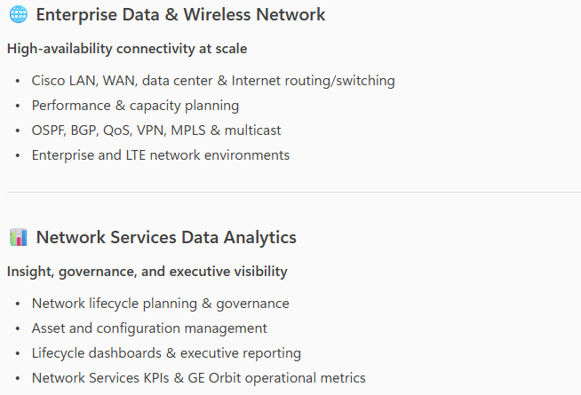
What is Network Services?
Notes:
Used CoPilot to reformat this area here. Copying and pasting the old information just in case we may need it:
Lifecycle engineering/design, support, and request work for all telecom and transport technologies, which includes:
Digital microwave & RF Backhaul Compliance – licenses management, RF safety and FCC regulatory influence
Fiber optics – Underground, OPGW and Fiber to Distribution
Dense Wavelength Division Multiplexing (DWDM)
Multi-Protocol Label Switching (MPLS) networks
Time Synchronization
Satellite data & voice services
Push-to-talk land mobile radio
Company Owned and Maintained (COAM) connectivity and 3rd party leased circuits
AMI
Fixed UE proliferation – LINC & Wireless carrier LTE
Telecom Consultants / Architects
Provides deep technical consulting expertise on all areas of telecom and transport technologies
Telecom Business Development Support
Primary interface to the business on initiatives considering opportunities involving telecom assets and technology and Telecom Change Management
Notes for Gabe:
Lifecycle engineering/design, support, and request work for all network technologies, which includes:
Firewall Services – Zoning and Micro-segmentation, Cloud access and application support, Security and Vulnerability Monitoring and Remediation, OS compliance and Life Cycle Management (HW & SW), Divestiture and Merger support, 3rd Party Vendor Access, Compliance with operational policies and procedures, FW policy management, Separation protocol compliance, Threat Response and Remediation, FW rules and policy auditing, Network Access Management and Control, Georgia Emergency Response Systems Support
Voice & Unified Communications – Enterprise Voice Architecture & Routing, Contact Center Infrastructure supported Electric and GAS, Video Platform, IP Softphone Applications, Microsoft TEAMS Voice application, Voice Recording Platforms, Remote Voice Services (VPN Phone), Support Corporate Conferencing System(s), Analog/POTS/Fax support, Circuit Management, NG E911 Services, and Plant Paging/Intercom systems.
Data Network – Cisco Routing and Switching on the Local Area Network (LAN), across the Wide Area Network (WAN), Data Centers, and Internet. Performance and capacity management planning. OSPF/BGP, QoS, VPN, Multicast, and MPLS support across enterprise networks including LTE environment.
Strategic Services & Fixed Wireless – Enterprise Network lifecycle program planning & tracking, Asset Management planning & implementation, Data visualization & reporting for Network lifecycle, Code & Configuration management, Network Services KPIs, and GE Orbit support KPIs.

Slide 9
Issue
Our enterprise network relies on thousands of Cisco devices across offices, data centers, and field locations. While this equipment follows defined End‑of‑Sale (EoS) and End‑of‑Life (EoL) timelines, lifecycle data today is fragmented, reactive, and difficult to visualize.
As a result, we struggle to:
Proactively identify aging or unsupported equipment
Align refresh timing with risk, cost, and operational impact
Ensure optimal SmartNet coverage and compliance
Provide clear, executive‑level insight into lifecycle risk
Cisco defines clear lifecycle milestones (EoS, EoL, Last Day of Support), but turning those milestones into actionable planning insight remains a challenge.

Slide 10
What Students Can Help Us Understand
Using data analysis and dashboards, help us answer:
What equipment is approaching EoS/EoL—and where (state, affiliate, county, lat/long) is the highest risk?
Are there sites within a specified radius of each other (Ex. 1 mi, 5 mi, 10 mi, etc.) where it would make sense to lifecycle the equipment together?
Which devices are past recommended lifecycle stages but still in production?
How is best to capture exceptions (if a device is active / “in production” but should be skipped or omitted from a project’s scope, how can that information best be captured and incorporated into reporting?
How does lifecycle status correlate with support coverage, security risk, and cost?
Where should we prioritize refresh or investment to reduce operational risk?

Slide 11


Data Analytics Prompt
How can we use our networking equipment data to evaluate current-state costs and
identify opportunities for improvement/optimization?
Provide a visualization / dashboard showing data to provide leadership with clear insights to support decision-making. Feel free to show metrics by state, affiliate, county, model or device type.
Include details on the process for loading data into the visualization / dashboard from data sources using inputs from our organization and output to a visualization tool.
Notes:
Reworded this to change the prompt from focusing on productivity. Let me know what you think about this rewording.

Slide 12

Provided Materials
Southern Company – UA Innovate 2026 Prompt.pptx (MS PowerPoint presentation)
Southern Company – UA Innovate 2026 – UAInnovateDataset.xlsx (MS Excel file)
Multiple worksheets (tabs) containing raw data from our device inventory
One worksheet (tab) containing the Glossary of terms used within the raw data

Slide 13
Assumptions & Considerations
Only active / reachable devices should be considered for this effort.
Values in NA's Device Type field should be transformed into either Switch, Router or Voice Gateway.
CatCtr and Prime are the sources of truth for access points and wireless LAN controllers. If any of those device types are duplicated in NA, then CatCtr and Prime should override those records. First two characters of host name (aka: name/deviceName/name/hostname) indicates the State the device is located in. Three characters after first two (State) of host name/deviceName/name/hostname is the site code.
Notes:
What do you think about hiding this slide? Not sure if we need the graphic at the bottom. I added Shawn's comment about the IOC sometimes closing the tickets in the next slide.

Slide 14
Judging: What Does Success Look Like?
Submissions will be judged on the following categories:
Technical Writing & Documentation
Visualization, Design & Organization
Automation
Data Accuracy
Functionality / Useability
Business Value

Slide 15

Housekeeping
Office Hours: Saturday, February 28th, 8:00 – 9:00PM CST

Slide 16

Q & A

